Slide 1
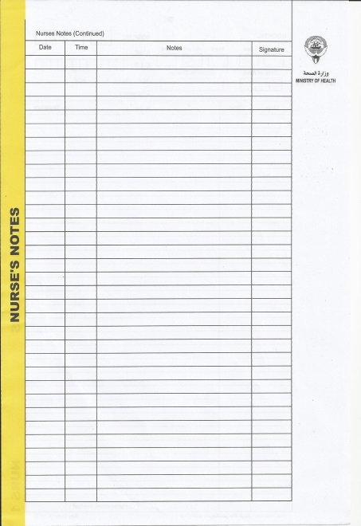
Management of
Nurses Notes
Presented by:
PhD. Mariam Mohammed
Assistant Director of Nursing
Staff Development Unit
Chest Diseases Hospital

Slide 2

Definition , purposes and principles of nurses notes
Frequently question asked about nurses notes.
How to write a nurse's SOAP note

Slide 3

Definition of Nurses Notes :
It provide communication tool among health team members regarding the care given to the patient and effectiveness. It helps to avoid duplication and omission of care.

Slide 4

Other… definition:
It is the independent assessment & interventions performed by the nurses. Medical orders carried out & its effect. Exact date, time of care & its outcome. Means of communication, enables personnel to supplement & complement one another’s services to avoid duplication or omission of care.

Slide 5

Purposes of Nurses Notes :
Nursing documentation for nurses interventions performed by the nurses. It is a used of communication, care planning, auditing, research and education, legal and holistic document.

Slide 6
Conti…Purposes of Nurses Notes
Communication : Within health care personnel & maintain the continuity of care.
Care Planning : Observe the patient’s progress.
Audit : Reviewing of the notes .
Research : To study similar cases
Education: Gives great deal about clinical manifestations, effectiveness of treatment.

Slide 7
Conti…Purposes of Nurses Notes
Legal Document : May be entered in the court proceedings as evidence.
Historic Documents : Can become the information needed in the future about the patient’s health.

Slide 8

Principles:
  1. Conciseness ( to save time)
  Concise & brief
  Use partial sentence /phrases and accepted abbreviations (universal).
  Do not tell a unimportant story

Slide 9

Conti.....
  2. Accuracy
Use designated form .
Be objective on your own observation (not your interpretation)
Write the name of the professional or physicians who checked the patient.

Slide 10

Conti….
  2. Conti… Accuracy
Avoid words like “good”, “average”, or “sufficient”; avoid generalizations “seems comfortable”
Use correct grammar & spelling.
Use only standard terminology.
Follow computer documentation guidelines. ( in some unit)

Slide 11
Conti….
3. Completeness
  Comprise (include ) of the whole nursing process such as assessment data signs and symptoms notifications, nursing interventions, physician’s order and patient’s response should be entered.
4. Organization
  Each entry must be logical & systematic as document the care chronologically according to time or procedure.

Slide 12
Conti….
5. Legibility
Recording must be clear & readable.
Use correct language
Document the nursing response to questionable medical orders or treatment (or failure to treat )

Slide 13
Conti….
6. Timeliness
Indicate the date and the time.
Timely recording is important when patient’s condition is changing rapidly, write more notations and enter it immediately.
Waiting on the end of the shift to write might cause omission of data & inaccurate information.
Never document before the interventions are done.
At least one notation per shift should be written.

Slide 14
Conti….
7. Confidentiality (Patient have a moral and legal right to privacy)
Treat all patient’s data as confidential
Do not leave the patient’s data anywhere (It should not be handled by a patient or relatives) .
Nurses should be familiar with hospital policy
Actual patient names and other identifiers should not be used in reports or in education ,research, case presentation…)

Slide 15
Conti….
8. Accountability:-
Never skip lines ,draw a single line through blank space
Use both sides of paper
Sign clearly your name (First name with the first letter of the family name) in each entry.
If there is an error, draw a single line, enter error and sign, and rewrite correctly. Re-write the entry correctly
Identify each page of record
Ensure patient record is complete before sending to medical record
Do not use white correctors
Use blue or black ink for documentation (black ink in original form )

Slide 16

Record observations – Not interpretations
Avoid generalization – eg. Seems comfortable
Note problems as they occur, record interventions and response
Document all medical visit and consultations ,so others should be aware.
Document the time physician notified and his response (by phone, face to face, etc)
Document also information given to supervisors.(ex incident report)
Any information related to fees (Payment )

Slide 17

Admission Notes:
Document the mode of admission and condition of the patient. (ambulatory, wheelchair, stretcher, walking, etc.)
Accompanied by whom
Describe the signs and symptoms(both subjective & objective data)
Mention the time doctor notified and the time when he visited the patient.
Any medications, investigations( to follow), files
Initial Vital signs – if relevant

Slide 18
Conti…Admission Notes:
Specify any unusual circumstances like police case or court case(Police cases/Court cases)
Note about valuables received from the patient.
Orientations given to the patient and relatives regarding the ward routine and hospital policy should be included.
Nursing care - evaluation

Slide 19

Transfer-in Notes:
Mention the mode of transfer and general condition of the patient.
Accompanied by – S/N, Relatives
Which Dr. seen him, under which unit Dr
Signs and Symptoms – objective/subjective
Received – file, investigations, X-rays, ECG

Slide 20
Conti…Transfer-in Notes:
Medications, appointments (to be follow), etc
Any urgent investigations results due
Specify the disposition of valuables and who received it.
Time doctor informed and time seen by him
Document the handing over of appointments for procedure and investigation reports.

Slide 21

Discharge Notes:
Discharged by doctor name .
Mention the mode of discharge of the patient and to whom discharged and Where ( alone , family, home or another hospital)
Specify the instructions given to the patient about medication and health teachings.
Record the documents given to the patient related to investigations, appointments and discharge summary or medical reports.
Valuables

Slide 22
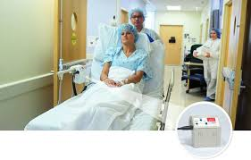
Pre-operative notes:
Preparation (psychological, skin, bowel, etc.)
Special Instructions
Special treatments & pre-medications given
Sent to OT time and handed over, File, X-rays, investigations and special medications.
Consent .
Nursing Care – evaluation

Slide 23
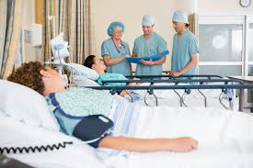
Post-operative Notes:
State the time patient returned from theater, the surgery performed with the anesthesia given.
Describe the general condition of the patient like vital signs, consciousness, surgical dressing, and drains.
Subjective observation

Slide 24
Conti… Post-operative Notes:
Handed over – file, x-rays, appointments, special investigations, special cases, medications.(be sure this information's in your post operative checklist )
Special instructions/nursing care
Monitor the progress (depend to the Hos. policy or patients condition or doctor order ).

Slide 25
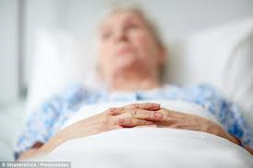
Bedridden Patients:
General skin care, mouth care
Condition of skin
Subjective (patient or relatives) and objective
Tolerance of food/feeding
Elimination – stool type, character amount
Teachings to relatives – NGT, Diabetic, food
Doctors visit, specific orders
Special observations – care
Evaluation of progress/condition/care
“At least one for stable and chronic patient”

Slide 26
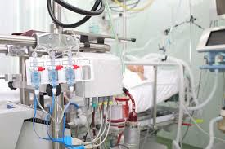
Critically-ill Patients:
More than one notation per shift
Relevant to change of condition
Nursing care - evaluation

Slide 27
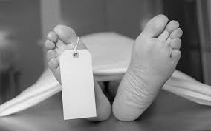
Dying/Post-mortem Care:
Time observed – condition of the patient
Notification to doctor, time seen by him/her
Vital signs – specific care given – CPR
Resuscitative measures done by Dr……
ECG Rhythm, O2 sat, O2 administration ,etc.
Specify the time of death and the name of the physician who pronounced the death.

Slide 28
Dying/Post-mortem Care:
Post mortem care given
Mention the time the body handed over to the relatives or the PRO with their names.
Document the about the valuables of the patient as sent to the account section or the PRO.
Files, notification, etc
Time taken to mortuary(out of the ward or unit)

Slide 29


Slide 30
1) If my assign patient has no complaints and has stable condition I didn’t give much nursing care, how often should I write the nurses notes ?
At least one notation during the shift
You can enter his routine care like medications, sos, prn, stat, doctors visit, health teachings etc.
Example :
11.30am He is anxious about his discharge, seen by doctor, he advised him to wait until we receive the results of C.T scan. Reassured him. -------------------------------------Mohammed. M

Slide 31
2) What will happen if I am not writing a note stating “received patient” at 7am and he absconded at 9am or had a cardiac arrest. What proof I have taken care of the patient?
Example :
9:00am: Patient left the ward without informing. He was seen here at 8am, talking to patients beside his bed and to the nurses, informed Dr. Ibrahim and incident report written.------------------------- Mohammed. M

Slide 32
3) If I am receiving a patient transfer in from ICU, CCU, or vice versa, do I have to put a new nurses note paper?
Nurses notes are continuous notations – so do not put a separate paper, but write the transfer in note continuously.
Put a new nurses note if you are admitting a patient from other hospital as the files also will be separate.

Slide 33
4) One of the principle of nurses note is ‘conciseness’ , then why I can not use abbreviations, it will save the time and energy?
Universally accepted abbreviations are understood by all, but general abbreviations created gives different meaning to everyone.
Eg: received by W/C. This abbreviation can be Water Closet or Wheel Chair

Slide 34
5) If the patient is OK, can I write ‘fair’ or ‘good’ on my notes?
All these terms or ratings are different to people. Fair, good, normal, appears, seems, sufficient, average etc. are not acceptable because they lead to conclusions that can not be supported by objective information.

Slide 35
6) If I make a wrong entry, I could scratch it using the same pen, erase it with white corrector?
No. The correct way is just draw a line on the incorrect entry, and put your initial and write ‘error’ , so that it remains legible
Example :
Error N.A
10am Patient returned from theatre after surgery with(wound drainage) suprapubic drainage.------------------------------------------------Nadia Ahmed

Slide 36
7) If I have a serious, critically ill patient who need attention always, his condition is changing on and off – can I enter the information by the end of the shift as it is time consuming to enter notes every time?
No. you have to enter the important information instantly after the care – chronologically – you may forget some important facts if you are waiting till last.

Slide 37
How to Write a Nurse's SOAP Note
Instructions
    1
Write the "S" or subjective section. This includes everything the patient reports. Information in this section usually relates to the patient's complaint in his own words and includes any reported symptoms, their severity and their duration.

Slide 38
2
Write the "O" or objective section. This section details any information you observe while listening to the patient's complaints and performing an examination. If you notice ankle swelling as the patient reports pain, this is the section where you record it.

Slide 39
  3
Write the "A" or assessment section. Here, you include your diagnostic nursing assessment, as well as any lab test results you perform. If you are monitoring rather than assessing a patient, you note any changes in the patient's condition here.

Slide 40
  4
Write the "P" or plan section. This is the plan for treatment, including what medications or other therapies you will administer or advise.
This section should be actionable and thoroughly map out the course of treatment, as well as the intended outcomes and any necessary follow-ups, referrals or additional testing that is needed.

Slide 41
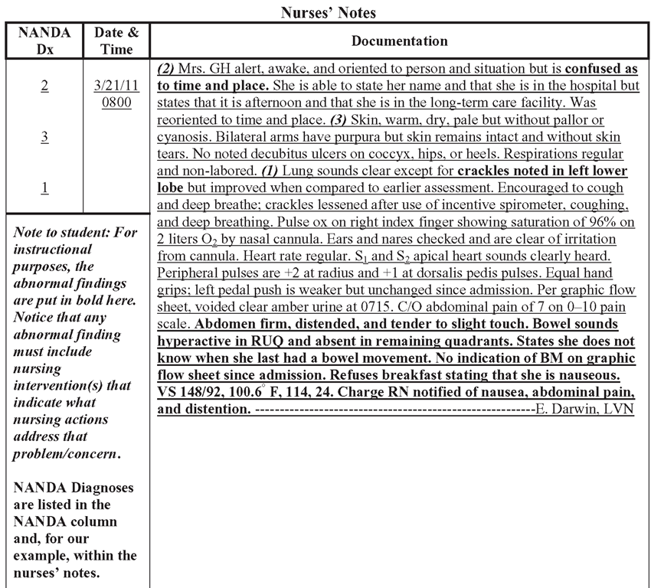

Slide 42
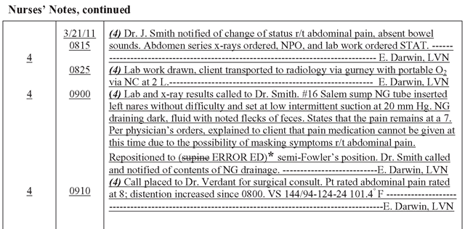

Slide 43
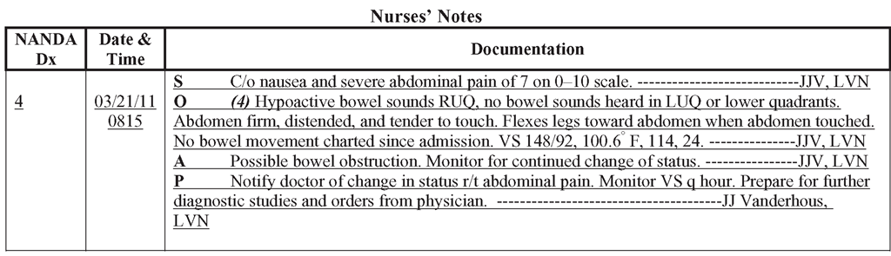

Slide 44
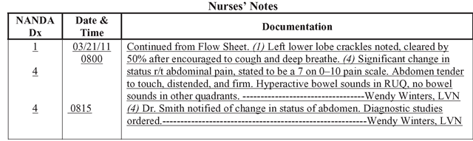

Slide 45


