Slide 1


Communication and Interpersonal Relationship
Dr. Mariam Mohammad
PhD. Pediatric Nursing
MSc. Pediatric Nursing
Clinical Instructor in Chest Diseases Hospital
Staff Development Unit

Slide 2

After this lecture group leader will be able to :
Define the communication
List the level of communication
Explain the importance's of communication
List the elements and process of communication
Discuss the pattern or channel of the communication.
List the classification or types of communication
Discuss the factor influencing the communication process
Explain the most common inhibitor of communication
Discuss the guidelines to effective communication

Slide 3

Define the therapeutic communication
Discuss the importance of therapeutic communication
Discuss the therapeutic and non- therapeutic communication technique
Explain the therapeutic communication barriers
Define the interpersonal relationship
Explain interpersonal response (Johari window)
List the stages of interpersonal relationship
Discuss the problems of interpersonal relationship
List the characteristic of enhancing interpersonal relationship

Slide 4

Introduction
Communication is a blood life of any organization and its main purpose to effect change and to influence action. In any organization the main problem is of maintaining effective communication process.

Slide 5
Conti…Introduction
The term communication is derived from the latien word “Communis ” which means common and thus if person communicates , he has established a common ground of understanding.

Slide 6
Definition of communication:
Communication can be defined as the transfer of information that is received and fully understood from one source to anther.

Slide 7
  INTRAPERSONAL COMMUNICATION
  It is conscious internal dialogue, sometimes known as self-talk.
  INTERPERSONAL COMMUNICATION
  It is communication between two or more people
Communication level
  GROUP COMMUNICATION (Small group) It is interaction that occurs among several people.
  PUBLIC SPEAKING: (Large group) Nurses often engage in public speaking to educate groups of people about health issues

Slide 8
Importance of communication
1. Managerial efficiency:
Communication helps in smooth operation of management.
2. Enhance morale and relations:
It helps to build the employees morale and relations between management and employees.
3. Effective leadership:
Effective leadership depends upon effective communication.

Slide 9
Conti….Importance of communication
4. Mutual trust and confidence:
Mutual trust and confidence is necessary for effective movement of organization.
5. Better decision:
The success of organization can be measured in better decision. When the information, data and other fact are not effectively communicated, it obstruct the decision making.
6. Staffing:
When the information are correctly communicates in time, it helps in the function of selection, employment, promotion and transfer.

Slide 10
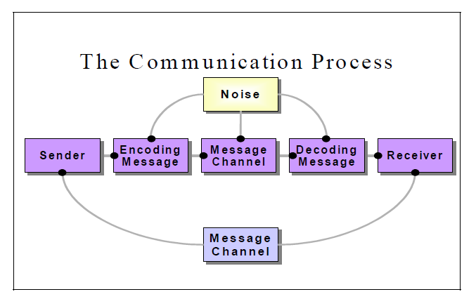
ELEMENTS AND PROCESS OF COMMUNICATION :
Feedback

Slide 11
Conti…ELEMENTS AND PROCESS OF COMMUNICATION :
Sender : The person who convey the message to others, also known as source or encoder.
Massage This is the subject matter of the communication (ex: what actually said or written by the sender (Verbal or non-verbal)
Encoding: Conversion of subject matter into symbols (ex: brain to mouth )
Communication Channel : Channel for sending the required information, ideas.. etc. which may be either formal or informal.

Slide 12
Conti…ELEMENTS AND PROCESS OF COMMUNICATION :
Receiver: The person who receives the message as who must listen, observe and attend.
Decoding: The person who receives the message or symbol from the communicator.(ex: ear to brain ).
Feedback: Is the process of ensuring that the receiver has received the message and understood in the same sense as sender meant it.

Slide 13


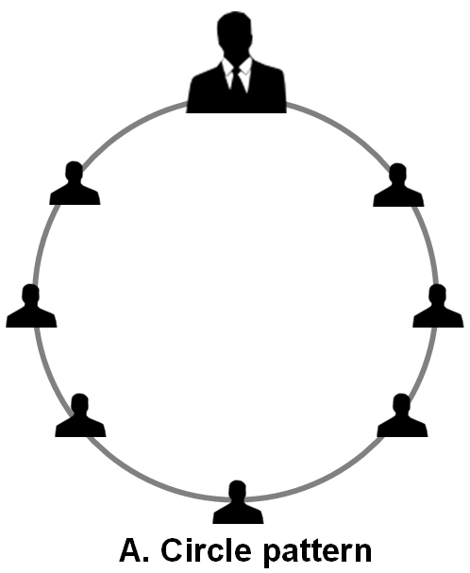
–
Communication Pattern (Channel)
Leader
In Circle pattern, the sender (Group Leader) can communicate with the receivers (group members) who presents next to him/her. No others group members can’t receive the sender’s message directly and they receive messages from the other group members who sharing the message from the sender.
Group Members

Slide 14
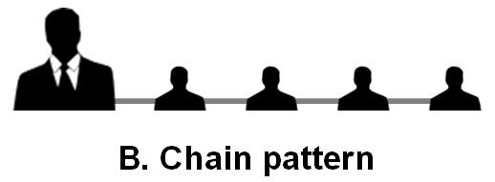
–
Conti…Communication Pattern (Channel)
Leader
Group Members
In Chain pattern, the same problems were appearing as like a circle pattern. The worst part in the pattern is the last member receives the modified messages from the leader. In this case the leader can’t find whether the last member receives the correct information or not because there is no feedback to identify the message distortion.

Slide 15
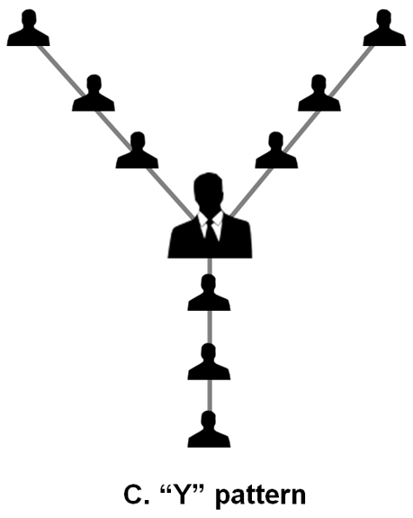
–
Conti…Communication Pattern (Channel)
Leader
In Y pattern, it’s more complicated pattern and also has the communication problem which appears in both circle and chain pattern. The group is separated into three and the group members can communicate with the other members group through leader only.
Group Members

Slide 16
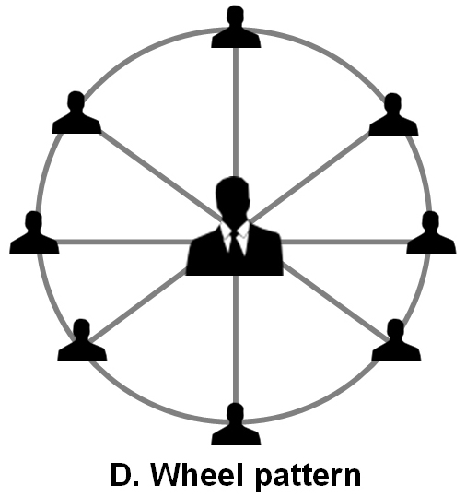
–
Conti…Communication Pattern (Channel)
Leader
In Wheel pattern, one of the best pattern while compare to other three. The leader has direct contact with all the group members and there are no communication problems, time issue and feedback from the group members. But all the group members can’t connect with one another
Group Members

Slide 17
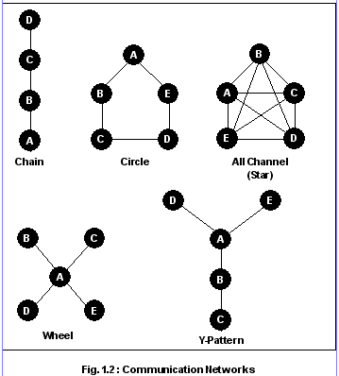
Conti…Communication Pattern (Channel)

Slide 18
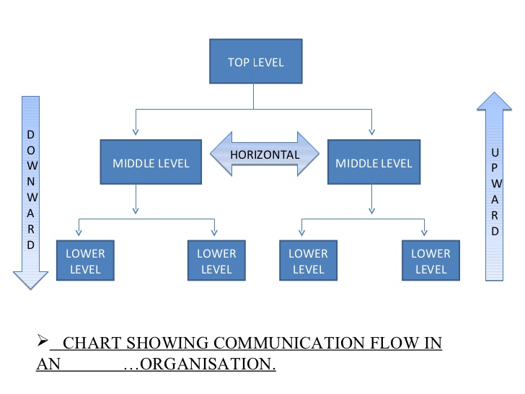
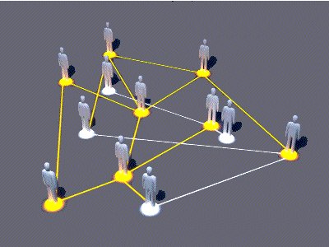
Communication Network (Channel )
Formal Communication
Informal Communication
Vertical and Horizontal

Slide 19
Conti… Formal Communication (examples )
  Upward communication as:
  Opinion
  Suggestion
  Complains
  Downward communication
  as :
  Circular
  Instructions
  Order

Slide 20
Factors influencing the communication process
Developmental (related to speech ,language and communication)
Gender ( speakers and listeners behaviors are affected by sex-linked differences )
Role and relationships ( communication is more effective when person aware of his/her roles in a relationship).
Social cultural background ( as language , value and attitude reflect culture origin. The influence of culture set limits for way people act and communicate)
Value and perception (each person understand the event differently)

Slide 21
Conti…Factors influencing the communication process
Space (intimate distance(1 1/2 feet ), personal distance (1 ½ - 4 feet ), social distances (4 -12 feet ) and public distances (> 12feet ))
Environment (loud, poor lighting, odors, uncomfortable temperature)
Time (Select proper time )

Slide 22

and…..Knowledge is essential for communication

Slide 23
Question
List some factors may influencing the communication process.

Slide 24
Classification of communication
Verbal communication
Uses of spoken or written words
Non-verbal communication
Uses other form as gestures or facial expressions

Slide 25

Verbal communication
Speaking
Reading
Writing
Listening
Discussion

Slide 26
Non-verbal communication
Eye contact
Facial expression
Gesture
Posture
Touch
Voice tone
Proximity

Slide 27
Discussion
Over the last three days, you observed people in conversation from distance so that you can not clearly hear the words being spoken. What cues you can observed?
( Anger , happiness, sadness, rel, agreement, boredom, impatience )

Slide 28
Inhibitors of Communication
Differences in meaning
(G.L should invest time to know team member)
Insufficient trust
(Trust building between GL and employee is important )
Information overload
(G.L should simplify the information and summarize information conveyed to the employee)

Slide 29
Conti…Inhibitors of Communication
Interference
(G.L must be attentive to the environment when communication with employee planned)
Condescending tone
(G.L should never talk down to employee)

Slide 30
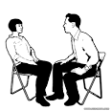
Conti….Inhibitors of Communication
Listening problem
Listening is receiving the message, correctly decoding it, and accurately perceiving what is meant.
(G.L should follow SOLAR Technique)
  Sit facing the client
  Observe an open posture
  Lean forward the client
  Establish eye contact
  Relax.

Slide 31
Conti….Inhibitors of Communication
Premature judgments (Quick judgments )
(G.L should listen, non-judgemenly when taking with employees)
Inaccurate assumptions
(G.L should build trust and listen to employee to get correct perception correct assumption )

Slide 32
Discussion
Have you experienced other inhibitors what are they and what problems did they cause?
(Ex : Technological )

Slide 33
when information conveyed is received and understood.
Communication
Versus
Effective communication
Effective communication when the information is received and understood is acted on in the desired manner.

Slide 34
Following are some of the guidelines to effective communication
Know your audience
Understand the ideas
Do not use the words which is vague meaning
Communication needs proper environment
Obtain feedback from your listener
Listen
Clarify your ideas before communication
Examine the purpose of each communication

Slide 35
Educate the nurses about
Therapeutic Communication

Slide 36
Therapeutic Communication
Definition
An interactive process between nurse and client that helps the client overcome temporary stress, to get along with other people, to adjust to the unalterable , and to overcome psychological block which stand in the way of self- realizations.

Slide 37
Therapeutic Communication
Definition
Therapeutic communication means that nurses use their communication in such a way that it will be benefit to their patient.

Slide 38
IMPORTANCE OF THERAPEUTIC COMMUNICATION
It impels a feeling of comfort in the face of patient
To increase self-worth or decrease psychological distress by collecting information to determine the illness
Assessing and modifying the behaviour and providing health information.

Slide 39
Techniques of therapeutic communication
Using silence
Accepting
Be specific and tentative
Using open-ended questions
Using touch ( placing your hand over the client’s )
Offering self ( ex: I will stay with you until daughter arrives )

Slide 40
Conti….Techniques of therapeutic communication
Seeking clarification
Giving information
Summarizing ex“during the past half hour talked about…”
Planning ex” tomorrow afternoon we may explore this further.

Slide 41
Educate the nurse to consider the following
Pace(speed) and intonation (tone)
Simplicity
Clarity(correct ) and brevity (few words)
Timing and relevance.
Adaptability (cognize of verbal and nonverbal)
Credibility ( believable and trustworthy)
Humor

Slide 42
Non- Therapeutic communication Technique
Stereotyping (offering generalized ex: “Most people don’t have any pain after this type of surgery” )
Rejecting (refuse to discuss certain topics with the client’s ex: “ I don’t want to discuss that let’s talk about…”)
Passing judgment (ex: ” what you did was wrong”)

Slide 43
Non- Therapeutic communication Technique
  What else …..

Slide 44
Therapeutic communication barriers
Physiological barriers
Social barriers
Cultural barriers
Ethical barriers

Slide 45
Conti…Therapeutic communication barriers
Physiological barriers to communication are those that result from limitations of the human body and the human mind (including memory, attention and perception ).

Slide 46

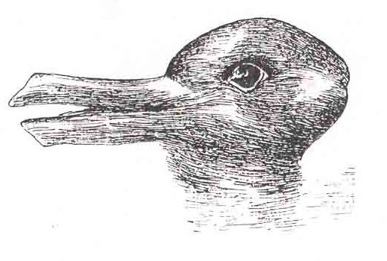
What’s your perception?
The quality and quantity of Communication is greatly influenced by G.L perception .

Slide 47
Conti…Therapeutic communication barriers
Social barriers to communication include the social psychological phenomenon of conformity; a process in which the norms, values and behaviours of an individual begin to follow those of the wider group.
Cultural barriers to communication, which often arise where individuals in one social group have developed different norms, values, or behaviours to individuals associated with another group.

Slide 48
Conti…Therapeutic communication barriers
Ethical barriers to communication; these occur when individuals working in an organization find it difficult to voice dissent, even though their organization is acting in ways they consider to be unethical

Slide 49
Discussion
Communication gap must be removed to ensure that workers are motivated to produce more ensuring higher productivity (How?)

Slide 50

Interpersonal relationship (IPR)

Slide 51
Definition of IPR
An interpersonal relationship (IPR) is a strong, deep, or close association between two or more people that may range in duration from brief to enduring.

Slide 52
Conti…Interpersonal relationship
The G.L is an important of the health care team that must work in co-operation and harmony for the care of the patient. This co-operation and harmony depends upon the IPR that is maintained among the members of the health care team.

Slide 53
Interpersonal Response (Johari window)
Johari Window is an important tool of interpersonal effectiveness and productivity. It provide an excellent way of understanding the relationship between various individuals. Johari Window consists of four quadrants representing four aspects of an individual in relation to others .

Slide 54
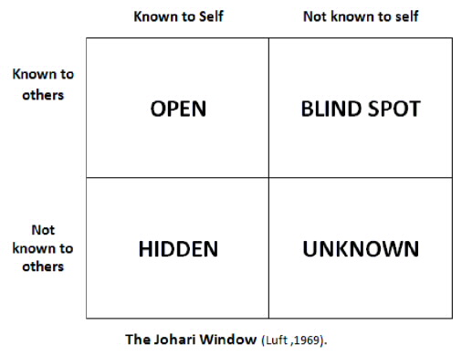
Interpersonal Response (Johari window)

Slide 55
Stages of the IPR
Orientation Phases(introduce yourself, assess client needs and accept it and clarify any limitation in delivery system environment).
Identification phase ( to encourage the client to express his/her feeling to clarify the perception and expectation .

Slide 56
Conti…Stages of the IPR
Exploitation phase(to mutual work on the solution to problems and to change needed to improve health)
Resolution phase(to formulate new goals and act more independently )

Slide 57
Problems of IPR (As asymptoms)
Loss motivation to work on the task
Resistance to suggestions
Difficult in reaching decision is a sure indication of interpersonal conflict.
Task distortion (ex: even decision has been made the action is undertaken )
Authority problem (ex: if one dislike the leader, so other group member may attacked him)

Slide 58
Characteristic of enhancing interpersonal relationship
Rapport or relation (Based on acceptance, warmth, friendliness, common interest, trust and
Non-judgmental attitude)
Trust (care, keeping promises, be honest ,ensure confidentiality)

Slide 59
Conti…Characteristic of enhancing interpersonal relationship
Respect (Spending time with pt, privacy, taking the pt ideas, preferences, planning)
Genuine(mean to be open ,honest and real)
Empathy(ability to see beyond outward behaviour and understand the situation from the client point of view and remain emotionally separate from the other person .This different from sympathy )

Slide 60
CONCLUSION
Communication is essential wherever there are people living and working together. Interpersonal relationship is also an important factor in our day to day communication, especially in the field of nursing. Considerable thought and attention have been given to the subject of IPR.

Slide 61
CONCLUSION
Communication and interpersonal relationship are both sides of a coin. So, Success for G.L……in the new global and diverse workplace requires excellent communication skills!

Slide 62
References
Basavanthappa, BT. (2009). Nursing Administration: New Delhi ,Jaypee Brothers Medical Publishers Ltd. Page236-59.
Goetsch, David L. (2002). Effective Supervision. A Guide Book for Supervision, Team leaders, and Work Coaches. Upper Saddle River, New Jersey Page 20-42.
Basavanthapa, B.T. (2009): Nursing Education: New Delhi, Jaypee Brothers Medical Publishers Ltd. Page14-110.

Slide 63


Slide 64


