Slide 1

Renal Failure in the Children
Prepared by:
Dr. Mariam Mohammad
PhD. Pediatric Nursing
M.Sc. Pediatric Nursing
Assistant Director of Nursing
Staff Development Unit

Slide 2


Introduction
Renal Failure
Definition, function ,anatomy , structure of the kidney
Normal finding in morning samples urine analysis
Dialysis
Kidney transplantation (KT)
Outlines

Slide 3
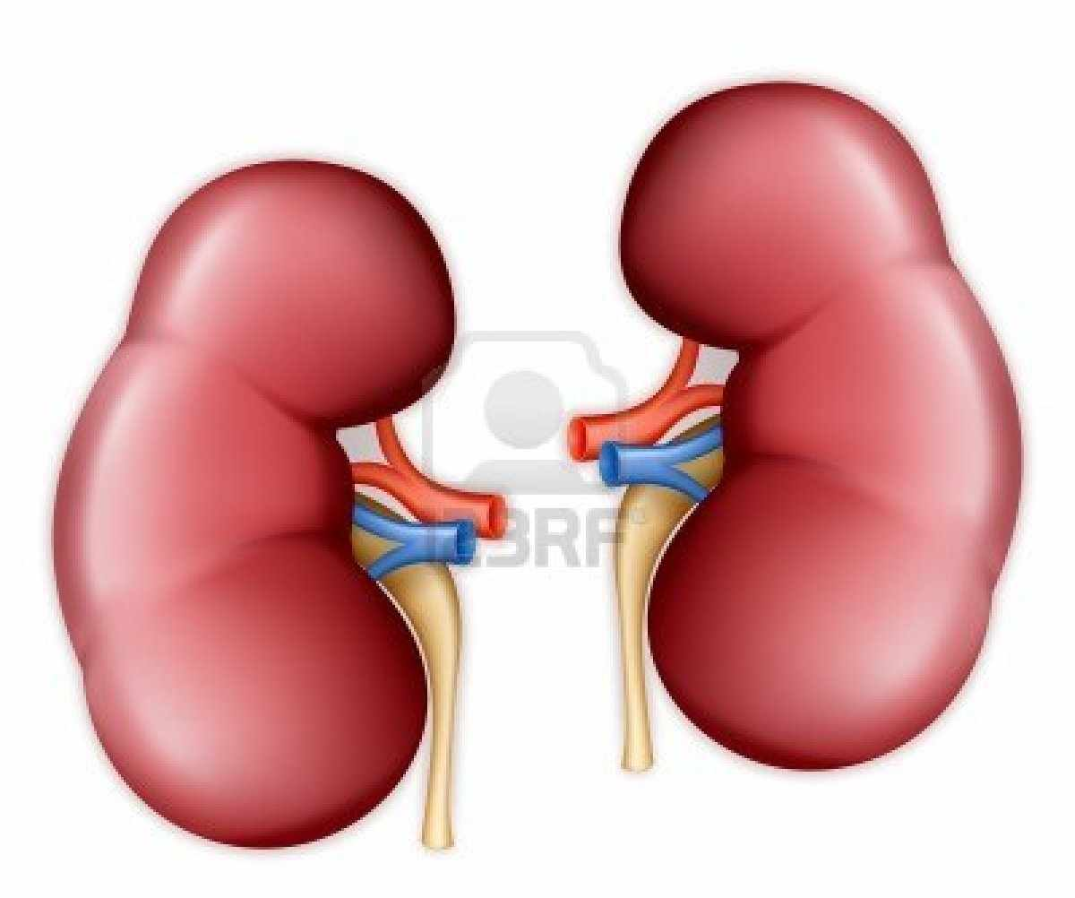
Definition of Kidney
The kidneys are a pair of bean-shaped organs found along the posterior wall of the abdominal cavity.
The left kidney is located slightly higher than the right kidney because the right side of the liver is much larger than the left side.

Slide 4
Function of the kidney:
Filtration of blood: Removes metabolic wastes ( or drugs)from the body, esp. those containing nitrogen
Regulation acid-base balance through hydrogen ion secretion and bicarbonate reabsorption and generation.
Produces renin hormone which regulates the blood pressure.

Slide 5
Conti..Function of the kidney:
The kidney produces erythropoietin which stimulates the bone marrow to produce red blood cells.
The kidney converts the inactive form of vitamin D from food into the active form that regulates calcium deposition in bones.

Slide 6
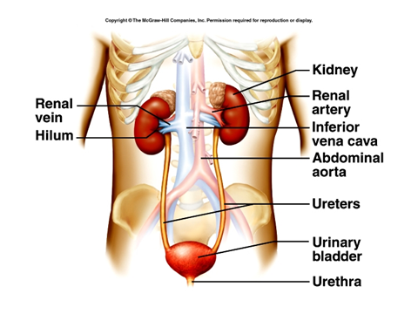
Anatomy
The two kidneys are located to the rear of the abdominal cavity on either side of the spine. Kidneys make up 1 % of body mass, but receive about 25% of cardiac output. The urine produced by each kidney drains through a separate ureter into the urinary bladder, located in the pelvic region. The bladder is emptied in turn by a single urethra, which exits the body.

Slide 7
Anatomy and Structure of the kidney:
Each kidney contains 1 million nephrons (nephron = glomerulus +associated tubule).
Number of nephrons is completed at birth, but functional maturation occurs later .

Slide 8
The role of nephrons
Filtering blood of small molecules and ions such as water, salt, glucose and other solutes including urea. Large “macromolecules” like proteins are untouched.

Slide 9
The role of nephrons
Recycling the required quantities of useful solutes which then re-enter the bloodstream. (A process called reabsorption).
Allowing waste molecules/ions to flow from the tubules/ureter as urine.

Slide 10
Each nephron is composed of two main structures:
Glomerulus
Renal tubule.

Slide 11
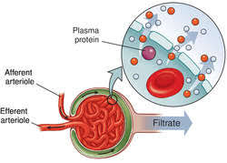
1- The Glomerulus
The glomerulus is a tiny blood vessel or capillary, which looks like a ball of yarn. Actual filtering of the blood occurs in the glomerulus. Each of the glomeruli helps keep normal proteins and cells in your bloodstream and allows wastes, excess fluid and other substances to pass.

Slide 12
2- The Tubule
The tubule, also called renal or kidney tubule, is a tiny tube where the wastes, extra fluid and other recyclable substances like sodium and potassium filtered out from the glomerulus pass through.

Slide 13
Damage to the Nephrons
Damage to nephrons can lead to kidney disease. Conditions that can affect the glomerulus are:
Glomerular Diseases
Lupus Nephritis
Nephrotic Syndrome
Immunoglobulin A (IgA) Nephropathy
Diabetes

Slide 14
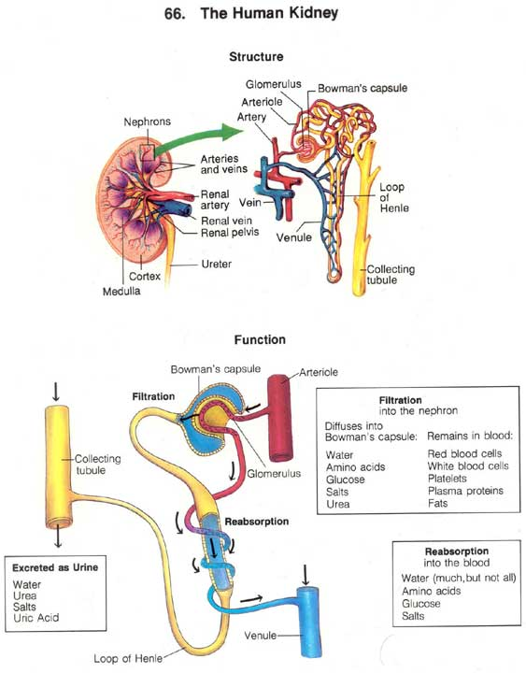

Slide 15
Normal finding in morning samples urine analysis:
Color: yellow.
Aspect : clear.
Specific gravity (1.020)
Glucose : - ve
Bilirubin : - ve and urobilinogen : trace
Protein : - ve
PH: 4.5 – 8 .

Slide 16
Conti..Normal finding in morning samples urine analysis: Sediment :
Cast : 0-1 \High Power Field (Hpf)
RBCS: 0-5 \ Hpf
WBCS: 0-5 \ Hpf
Epith. cells: few
Crystals : few oxalate ,phosphate (in alkaline urine) and urate (in acidic urine).

Slide 17
Renal Failure "RF"
It is the inability of the kidney to excrete waste material , concentrate urine , and conserve electrolytes.

Slide 18
Renal Failure "RF"
Acute renal failure (ARF) in response to inadequate perfusion, kidney disease ,or urinary tract obstruction
Chronic renal failure CRF) as a result of long standing kidney disease or anomaly .

Slide 19
Azotemia is the accumulation of nitrogenous waste within the blood and it is not life threatening .
Uremia is a more advanced condition in which retention of nitrogenous products produces toxic symptoms.

Slide 20
Renal Failure
Globally, the prevalence of chronic kidney disease (CKD) stage II or lower in children is reported to be approximately 18.5-58.3 per million children.

Slide 21
Renal Failure
Chronic kidney disease is more common in children older than 6 years than in those younger than 6 years were
19% in children aged 0-1 years
17% in those aged 6-12 years
33% in children aged 2-5 years
31% in those older than 12 years

Slide 22
Etiology and Pathophysiology:
The causes of chronic kidney disease (CKD) in children include the following:
Obstructive uropathy
Hypoplastic or dysplastic kidneys
Reflux nephropathy
Focal segmental glomerulosclerosis as a variant of childhood nephritic syndrome
Polycystic kidney disease, autosomal-recessive and autosomal-dominant varieties

Slide 23
ARF
Etiology and Path physiology:
May be caused by prerenal or postrenal factors as well as actual kidney damage.

Slide 24
Prenatal causes : (Madkour A 2009)
Blood loss : acute hemorrhage .
Plasma loss : burns.
Fluid loss : dehydration due to diarrhea, vomiting, fever, diabetic ketosis.
Septic shock .
Heart failure.
Hypoxia: pneumonia, respiratory distress syndrome.

Slide 25
Intrinsic renal causes :
Glomerulonephritis: as poststreptococcal glomerulonephriti.
Tubular: acute tubular necrosis; decrease renal perfusion , nephrotoxins.
Interstitial nephritis as drug.
Vascular : renal vein thrombosis.
Acute pyelonephritis .
Leukemic infiltration of kidneys.

Slide 26
  Post renal causes :
  Urethral obstruction : posterior urethral valve stricture .
  Bladder : neurogenic dysfunction
  Bilateral ureteral obstruction : calculi, blood clots, bilateral strictures .

Slide 27
Classification according The Kidney Disease Outcomes Quality Initiative (KDOQI)
Stage I :A normal glomerular filtration rate (GFR) (> 90 mL/min per 1.73 m²) and persistent albuminuria
Stage II : GFR of 60-89 mL/min per 1.73 m² and persistent albuminuria
Stage III: GFR of 30-59 mL/min per 1.73 m²
Stage IV: GFR of 15-29 mL/min per 1.73 m²
Stage V : <15 mL/min per 1.73 m² or end-stage renal disease (ESRD)

Slide 28
Conti…Clinical Manifestation:
Decease urine output : oliguria or anuria .
Edema (due to salt and water retention).
Pallor (due to anemia) .
Hypertension may progress to hypertensive encephalopathy .

Slide 29
Conti…Clinical Manifestation:
Uremic encephalopathy: lethargy, drowsiness, behavioral changes, convulsion, coma .
Gastrointestinal: anorexia, nausea, vomiting .
Acidotic breathing (deep rapid breathing).
Manifestation of electrolyte disturbance: Hyperkalemia, Hyponatremia, Increased blood urea and creatinine .

Slide 30
Diagnostic evaluation (Wong 2013 )
1- History
2- Laboratory measurement as : blood urea nitrogen, serum creatinine, ph, sodium, potassium, calcium.

Slide 31
Complication
Hyperkalemia
Uremia
Hypertension
Anemia
Cardiac failure
Water intoxication
Hyponatremia
Metabolic acidosis

Slide 32
Treatment
Initial emergency treatment of children with fluid depletion (hypovolemic) focuses on rapid fluid replacement at 20ml/kg of saline or lactated Ringer's solution giver over 30-60 minute, and repeated as needed to ensure adequate renal perfusion and stabilize blood pressure.

Slide 33
Treatment
Children with fluid overload (hypervolemia) need diuretic therapy, as well as dialysis if they respond poorly to diuretics.
Eliminate all potential potassium sources until Hyperkalemia is controlled.

Slide 34
Treatment
In children with ARF, dialysis is indicated to treat 3 major conditions:
hypervolemia unresponsive to fluid restriction or diuretics,
major electrolyte abnormalities unresponsive to medical therapy (hyperkalemia and acidosis), and
signs of uremia.

Slide 35
Nursing consideration
  Monitor fluid intake and output
  Monitor vital signs .
  Maintain optimal thermal environment .
  Reduction of body temperature .
  Reduction of anxiety and restlessness .

Slide 36
Chronic Renal Failure "CRF”
The diseased kidney can not longer maintain the normal chemical structure of body fluids under normal conditions.
Progressive deterioration over months or years produce a variety of clinical and biochemical disturbances that result in clinical syndrome known as uremia .

Slide 37
Etiology
Congenital renal and urinary tract malformations
Vasoicoureteral reflux associated with recurrent urinary tract infection
Chronic pyelonephritis
Hereditary disorders
Chronic glomerulonephritis and glomerulonephropathy

Slide 38
Clinical manifestation
Early signs :
Loss of normal energy
Increase fatigue in exertion
Pallor
Elevated blood pressure sometimes

Slide 39
As the disease progress
Decreased appetite
Less interest in normal activity
Increase or decrease urine output with compensatory in take of fluid
Pallor

Slide 40
Child May Complain Of
Headache ,Muscle Cramps ,Nausea.
Weight Loss
Facial Edema
Malaise
Bone or Joint Pain

Slide 41
Growth Retardation
Dryness or Itching of The Skin
Bruised skin
Sensory or motor loss
Amenorrhea

Slide 42
Uremic syndrome (untreated)
Anorexia , Nausea , Vomiting.
Bleeding Tendencies: Bruises ,Bloody Diarrheal Stool, Stomatitis, bleeding from lips and mouth
Itching
Uremic frost ( deposits of urea crystals on skin)
Unpleasant uremic breath odor

Slide 43
Deep respiration
Hypertension
Congestive heart failure
Pulmonary edema
Neurological involvement
progressive confusion, coma , tremors, muscular twitching, seizures

Slide 44
Complication
Anemia
High blood pressure (hypertension)
Increased risk of bleeding
Increased risk of infection
Fluid overload (called edema)
Dehydration

Slide 45
Electrolyte abnormalities (e.g., hyperkalemia, high levels of potassium in the blood)
Mineral abnormalities (e.g., hypercalcemia (high levels of calcium in the blood) or hyperphosphatemia (high levels of phosphorus in the blood))
fragile bones
Malnutrition
Seizures

Slide 46
Treatment
The course of treatment on CRF is variable. Some children progress quickly to ESRD requiring immediate Renal Replacement Therapy "RRT", some are managed with combination of medications and diet therapy for some time before significant renal impairment occurs.

Slide 47
Dietary management focuses on maximizing caloric intake for growth while limiting phosphorus, potassium, and sodium intake as needed to keep electrolyte in balance. Adequate calcium intake needs to be part of diet plan.

Slide 48
Optimal of high-quality protein (meat, fish, and egg whites) is needed by 2-2.5 g/kg/day for infants, and 1.5-2 g/kg/day for older children.
Complex carbohydrates should be chosen along with vegetables and fruits that are lower in potassium.

Slide 49
Medications used in CRF are: Vitamin and Mineral Supplements, Phosphate-Binding Agents (calcium carbonate) to reduce phosphorus absorption from the intestine, Epoetin Alfa to stimulate bone marrow to produce RBCs to treat anemia, Growth Hormone, and Iron Supplementation

Slide 50
The European Guidelines 2004 of Renal Replacement Therapy for Children with Renal Failure
Recommendation 1:
All children with RF require discussion with a pediatric nephrologist. Early transfer for investigation and management is essential in those with rapidly deteriorating renal function or in those with hemodynamic or biochemical disturbances

Slide 51
Recommendation 2:
All children with ARF as part of multi-organ failure require transfer to a designated regional pediatric ICU where there should be access to pediatric nephrology advice and support.

Slide 52
Recommendation 3:
There is no evidence for the optimum level of renal function neither for starting renal replacement therapy nor for the optimum dialysis modality.

Slide 53
Recommendation 4:
The choice RRT has always to be individualized, balancing advantages against disadvantages.

Slide 54
Nursing Management of Children with Renal Failure:
Nursing management focuses on preventing complications, maintaining fluid and electrolytes balance, administering medications, meeting nutritional needs, preventing infection, and providing emotional support to the child and parents.

Slide 55
Prevent Complications:
Complications can be best prevented by:
Ensuring compliance with the treatment plan.
Careful monitoring of vital signs.
Intake/output charts.
Serum electrolytes are monitored.
Monitoring level of consciousness.

Slide 56
Maintain Fluid Balance:
Daily monitoring of weight.
Measuring blood pressure 2-3 times a day.
Monitor sodium serum levels.
In case of oliguria, limit fluid intake.

Slide 57
Administer Medications
Because the kidneys' ability to excrete drugs is impaired, dosages of all medications should be adjusted. The actually dosage of the drug can be decreased or the time intervals between doses can be increased.

Slide 58
Meet Nutritional Needs
High metabolic rate can encounter children to the risk of malnutrition.
Sodium, potassium, and phosphorus are restricted depending on the degree of RF.
The diet is tolerated to the individual child's needs of calories, carbohydrates, and proteins
Provide small frequent feedings.

Slide 59
Prevent Infection
The child with RF is extremely susceptible for infection because of altered nutritional status, compromised immunity, and numerous invasive procedures.
Good hand hygiene and standards precautions are to be followed.
Use sterile techniques for all invasive procedures.
Assess vital signs continuously.

Slide 60
Dialysis
Is a procedure for cleaning and filtering the blood . It substitute for kidney function when the kidney can not remove the nitrogenous waste products and maintain adequate fluid, electrolyte and acid base balance .

Slide 61
Dialysate
Is an aqueous fluid ,it`s composition is similar to normal human plasma usually containing isotonic concentration of sodium and chloride ions, low concentration of potassium, calcium, and magnesium ions, and high concentration of bicarbonate and glucose .

Slide 62
Indication of dialysis
Acute indications for dialysis\ Hemofiltration
Hyperkalemia.
Metabolic acidosis.
Fluid overload ( pulmonary edema) .
Uremic pericarditis.
Patient without renal failure , acute poisoning with dialyzable drug such as aspirin , lithium.

Slide 63
Chronic indication for dialysis
Symptomatic renal failure.
Low glomerular filtration rate (GFR).
Difficulty in medically controlling serum phosphorus or anemia when GFR is very low.

Slide 64
Physiological principles of dialysis
Diffusion (Diffusion is the net movement of molecules or atoms from a region of high concentration (or high chemical potential) to a region of low concentration)
Osmosis (Osmosis is the spontaneous net movement of solvent molecules through a selectively permeable membrane into a region of higher solute concentration)
Ultrafiltration (In hemodialysis water is removed by hydrostatic ultrafiltration which is a pressure phenomenon. The pressure on the dialysate side is lowered and water moves from a place of higher pressure to one of lower pressure, i.e., out of the plasma.)

Slide 65
Peritoneal Dialysis "PD":
It is uses the peritoneum , the semipermeable membrane lining the abdomen to filter fluid , waste and chemicals .
The dialysate is instilled and drained forth the abdominal cavity by means of catheter . substance pass from the tiny blood vessels in the peritoneal membrane into the dialysate. It used for acute and chronic renal failure.

Slide 66
Care during peritoneal dialysis :
Maintain aseptic technique to prevent infection.
Monitor vital sign frequently.
Maintain intake and output record.
Assess patient for edema .
Assess catheter site for infection.
Maintain accurate record for each cycle : type, amount, time, and characteristic of dialysate.

Slide 67
Post-operative Management of PD Catheter ( Royal Hospital for Sick Children 2010)
Avoid excessive movement at the exit site.
The patient should mobilize gently over the following 24 hours.
The child should not return to school for a week.
Heavy exercise should be avoided for 6 weeks.
Swimming is not allowed.

Slide 68
The initial dressing should be left undisturbed for a week.
If the dressing comes loose, the parents should be instructed to secure the dressing
If there is a hematoma along the catheter tract, a two week course of oral co-amoxiclav should be given (according to age and estimated GFR)

Slide 69
After one week, the child should shower daily and have the dressing changed daily, following discharge dressing guidelines.
The exit site should be assessed weekly throughout the bedding in period.
Written information leaflets to be provided to the family.

Slide 70
Advantage
Inexpensive
Hemodynamically well tolerated
No vascular access well required.
No anticoagulant therapy will needed.
Any location can be used and machine is not needed .
The process can be easily taught to the patient and family.

Slide 71
Advantage
The procedure can be used for people are heamodynamically unstable.
The patient has more control over daily life .

Slide 72
Disadvantage
Slow correction of fluid and electrolyte disturbance.
High risk of peritonitis .
May be leakage of peritoneal dialysate.

Slide 73
Complication
Hypotension .
Hypovolemia.
Inadequate drainage of fluid from peritoneal space.
Pain, atelectasis, respiratory distress and pritonitis.

Slide 74
Hemodialysis
Transporting blood from the client through a dialyzer , a semipermeable membrane filter in machine .
Water and wastes from the blood move into the dialysate fluid that flows around the fibers , but protein and RBCs do not. The entire cycle takes 4-6 hrs and performed 3 time \ week.
For client with CRF are arteriovenous fistula (AV) and AV graft.

Slide 75
Advantage :
Fluid and electrolyte abnormalities are corrected rapidly .
It is better tolerated by many patient
Disadvantage:
More expensive than peritoneal dialysis
Greater homodynamic risk (hypotension, hypoxia , hemorrhage ).
Anticoagulant therapy will required.
Vascular access will required.

Slide 76
Pre dialysis care
Adequate explanation of child of what happen and what will expected from them during dialysis , what type of pain will experience, how long dialysis will occur , what allowed during dialysis , what should feel during and after dialysis.
Record weight , vital sign .

Slide 77
Assess fluid overload (neck vein, periorbital edema,)
Assess vascular access for patency and infection.
Blood sample is drawn to determine the level of electrolyte and waste product .

Slide 78
Care during hemodialysis:
Change patient position.
Oral care is required if there is nausea or vomiting.
Check blood pressure and pulse every 30 to 60 minute .
Monitor blood flow and dialyzer pressure setting .
Withhold rapid acting antihypertensive the morning of dialysis.

Slide 79
Care during hemodialysis:
Evaluate the need for withholding medication that predispose to hypovolemia .
Watch sign of bleeding.
Monitor clotting time frequently during dialysis.

Slide 80
Post dialysis care
Record the patient weight to determine the amount of fluid loss during treatment
Assess vital signs.
Teach the family :
  Common complication of hemodialysis (infection , constriction , bleeding ).
  Where to obtain care if complication occur .

Slide 81
Post dialysis care
  Care of vascular access .( inspect the skin over fistula or graft for sign of infection, wash skin with soap and water, avoid puncture at the same site )

Slide 82
Pediatric Nephrology (Berlin, Germany) Hemodialysis in children general practical guidelines2005
Hemodialysis in children has benefited from major progress over the last 20 years. The morbidity of the sessions has decreased, even disappeared, seizures being exceptional, hypotensive episodes or headaches rare, and pain related to the fistula puncture effectively prevented by xylocaine ointment.

Slide 83
The newer machines enable precise control of ultra filtration volumetric assessment and continuous blood volume monitoring during the session, buffered bicarbonate has become a standard technique, synthetic more biocompatible membranes and specific material available for babies/infants have been developed

Slide 84
Last, the availability of erythropoietin and of growth hormone and the promising results from enhanced dialysis dose on both growth and cardiac function, all give the dialyzed child a real increased quality of life.

Slide 85
In theory, reduction of dialysis prescription to only a urea dialysis dose achieved by three short (3-h) dialysis sessions, should be abandoned for long term dialyzed children and replaced by optimum dialysis obtained with longer (4 and more hours) and/or more frequent (daily: 5 to 6) sessions.

Slide 86
But for such a daily dialysis strategy all the costs must be considered. On the one hand the financial cost cannot be neglected.

Slide 87
Daily hemodialysis is one approach, perhaps the only one, to achieve phosphate purification and thereby maintain the calcium × phosphorus product in the optimum range of 3.3 to 4.4 mmol2 mL−2.

Slide 88
Complications of acute PD:
Leakages can be a difficult problem and are mostly due to a leakage around the catheter. The incidence can be reduced by proper surgical technique or resurturing around a percutaneous catheter.

Slide 89
Complications of acute PD:(AAP2010)
Poor drainage due to mechanical blockage or catheter migration is all too common. Flushing the catheter and preventing fibrin accumulation by increasing the heparin dosage and/or urokinase is suggested initially.

Slide 90
Complications of acute PD:
Hernias can be a problem in neonates and infants, particularly males. They do not usually require interruption of PD and can be repaired electively by laparoscopic or direct measures when the child’s clinical condition has improved or stabilized.

Slide 91
Complications of acute PD:
Peritonitis remains a constant threat, especially if there has been a lot of manipulation of the catheter. The standard features of cloudy PD fluid require urgent attention.

Slide 92
Complications occurring during acute HD
For hypotension, the ultrafiltration should be switched off and isotonic saline infused into the venous line until the blood pressure normalizes; additional 20% albumin 5 ml/kg might be helpful.

Slide 93
Complications occurring during acute HD
Hypertension is treated according to standard hypertension protocols available elsewhere.
Hypoglycemia should not occur with the use of glucose-containing dialysis fluid.

Slide 94
Complications occurring during acute HD
In cases of anemia, Erythropoietin may be given intravenously at the end of dialysis (50–200 IU/kg) to maintain hemoglobin levels.
Disequilibrium syndrome is now a rare event with adequate control of ultrafiltration and stepwise reduction of uremic toxins.

Slide 95
CDC recommendations for preventing the transmission of infections in dialysis facilities.
These recommendations include:
Surveillance and immunization for hepatitis B
Using gloves any time contact is made with a dialysis machine
Carefully monitoring how medications are administered

Slide 96
CDC recommendations for preventing the transmission of infections in dialysis facilities.
Appropriate handling of dirty dialyzers
Appropriate disinfection of the vascular access prior to cannulation
Practices that prevent the potential for using supplies between patients (i.e., if something is taken to a patient station for use, it should not then be taken to another patient station).

Slide 97
These infection control practices include the following:
No food/drink in unit
Limited family visits
Hand washing and hand sanitizing
Double bagging hazard trash
Disinfection of dialysis equipment and blood spills
Ensuring equipment is in good working condition and placed in correct storage areas

Slide 98

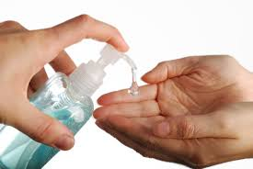
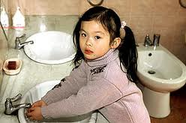

Slide 99
These infection control practices include the following:
Monitoring staff and patient serum status
Clear designation of clean and dirty areas in the unit.(High light)
Staff education about laundering scrubs at home for patients.
Close supervision of new and inexperienced staff .

Slide 100


Slide 101
These infection control practices include the following:
Proper barrier and staff PPE Special attention to hemodialysis control panels with regard to blood spills (a high touch area)
Dressings and antiseptics that are catheter compatible and effective.

Slide 102
2011 Journal Citation Reports® (Thomson Reuters, 2011) Kidney Transplantation; American Journal of Transplantation

Slide 103
Kidney transplantation (KT),
This is a procedure that is increasingly being recognized of difficult modification, both in optimizing patient selection for the procedure and insuring optimal care, and in developing appropriate organ allocation regulations. A kidney transplant is surgery to replace diseased kidneys with a healthy (donor) kidney.

Slide 104
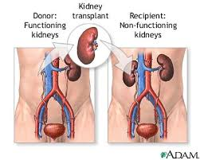

Slide 105
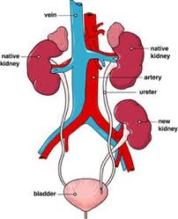

Slide 106
Types of donors
There are two types of donors:
Living donors. A living donor may be a family member, a friend, a coworker, or any person who is willing to give a kidney to someone in need. A person only needs one healthy kidney to live.

Slide 107
Types of donors
Cadaver donors. A cadaver donor is someone who has recently died. Most donor kidneys come from this source.
In both cases, the key to success is having the closest possible blood and tissue matches. A family member is not always the best match

Slide 108
Kidney transplant surgery
Kidney transplant surgery takes about 3 hours. During surgery, the donor kidney will be placed in lower abdomen blood vessels from the donor kidney will be connected to arteries and veins in body.

Slide 109
Kidney transplant surgery
The ureter from the donor kidney will be connected to bladder. Blood is then able to flow through the new kidney, and the kidney will begin to filter and remove wastes and to produce urine.

Slide 110
Kidney transplant surgery
The new kidney usually begins to function right away. In most cases, diseased or damaged kidneys are not removed unless you have a severe infection of the kidney.

Slide 111
Post operative medicines:
After the surgery a medicines to suppress immune system, are used to help keep the body from rejecting new kidney. These medicines used for the rest of life.

Slide 112
Kidney transplantation complication
Chronic rejection is a process of gradual, progressive loss of kidney function and can occur many months to several years after surgery. Experts don't fully understand what causes chronic rejection. There is no treatment for chronic rejection. Most people go back on dialysis or have another transplant.

Slide 113
Kidney transplantation complication
Other complication as, severe infection, bleeding, reaction to the anesthesia used for surgery, failure of the donor kidney.
Complications of the immunosuppressive medicines as increased risk for serious infections.

Slide 114
Kidney transplantation complication
There is also the chance that body may still reject new kidney even with medicines. If this happens, child will have to start dialysis and possibly wait for another kidney transplant.

Slide 115
Kidney transplantation complication
Immunosuppressive medicines also increase risk of other diseases, such as skin cancer and lymphoma. A greater risk for diabetes, high blood pressure, heart disease, cataracts, and inflammation of the liver (cirrhosis).

Slide 116

Thank you
Thank you

